Slide 1

2024 Paradise Gardens Annual Homeowner Association Meeting
November 12, 2024

Slide 2
Agenda
1.) Parking
2.) Towing
3.) Community Park (Lights, Benches, Misc
4.) Gutters
5.) Community Signs
6.) Fall Festival (In December)
7.) Cleanliness & Tidiness
8.) Usps/Mail Issues
9.) Security / Safety Concerns
10.) Formation of subcommittees

Slide 3
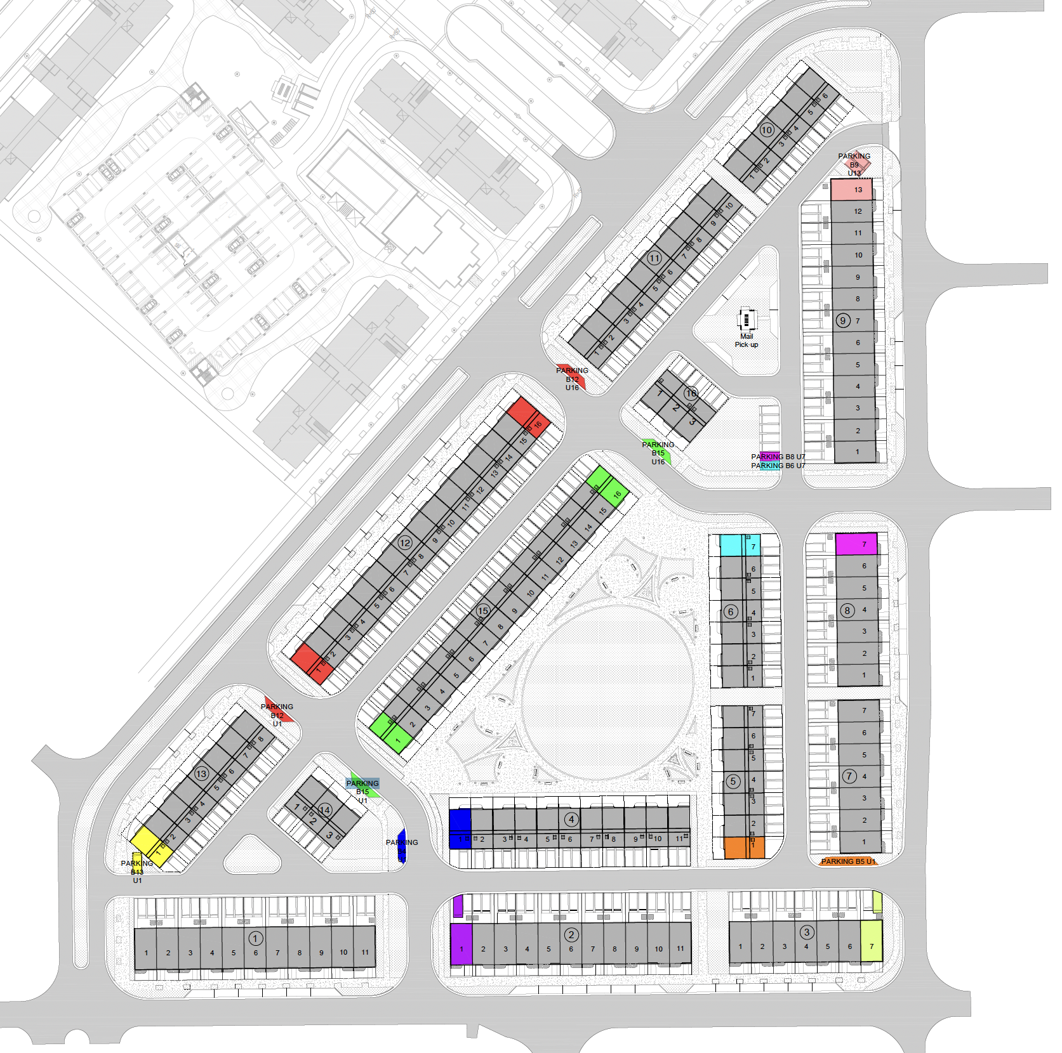
Parking
Parking Around the Perimeter
Interior Guest Parking
“Reserved” Parking
Please Provide a copy of the title to the HOA indicating/proving ownership of ‘reserved’ parking spaces in your parcel/lot from the county

Slide 4
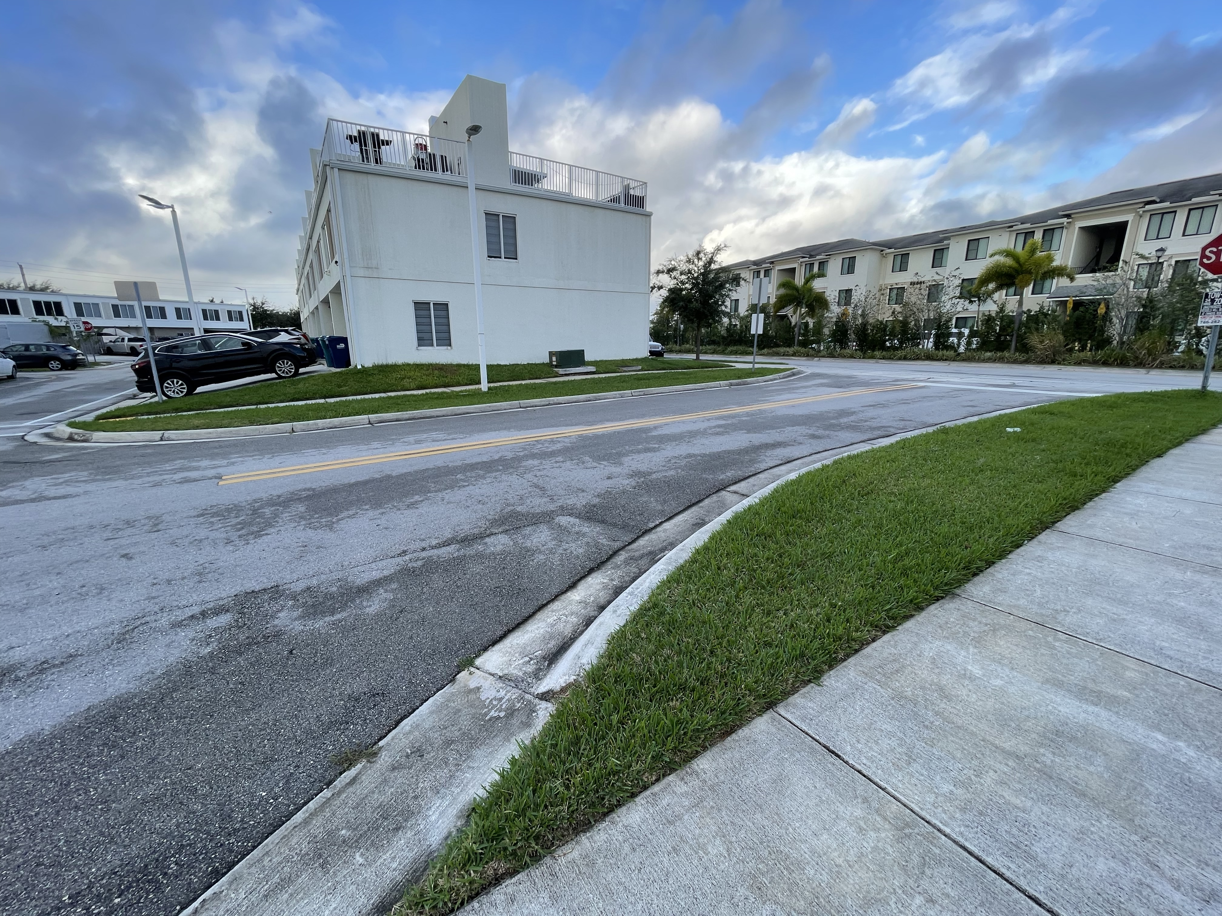
Proposed Parking Additions

Slide 5
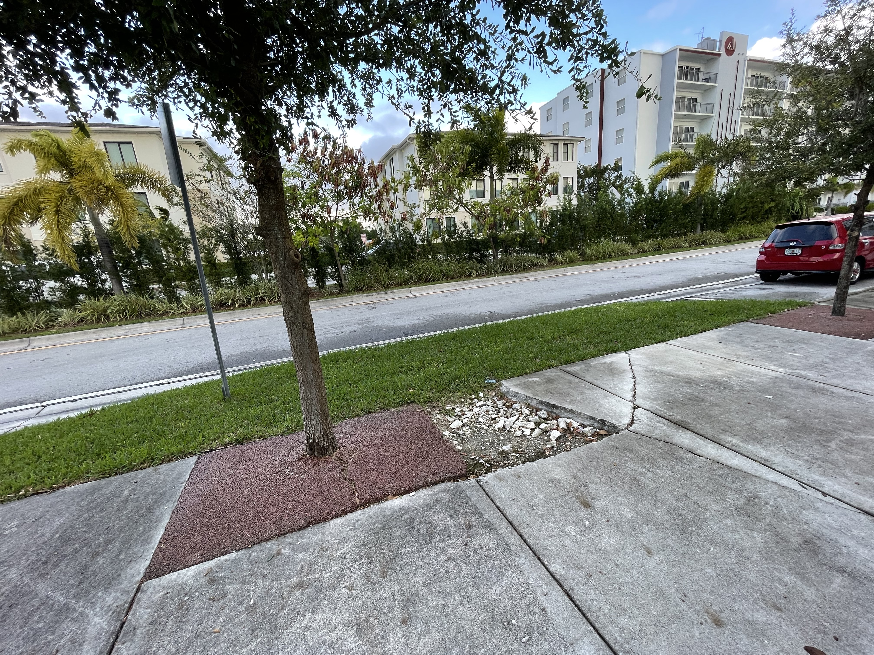
Proposed Parking Additions

Slide 6
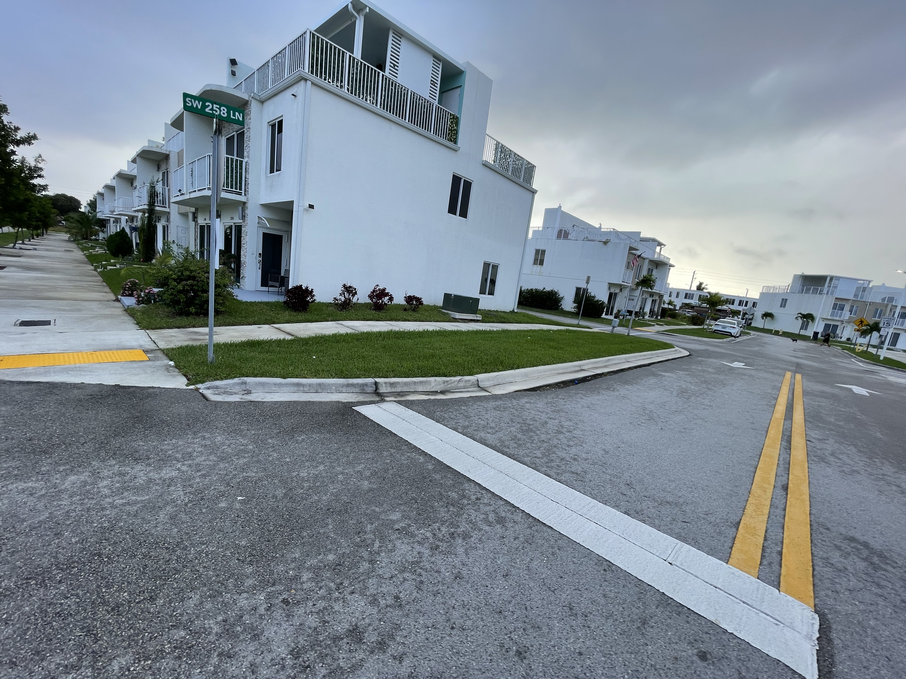
Proposed Parking Additions

Slide 7
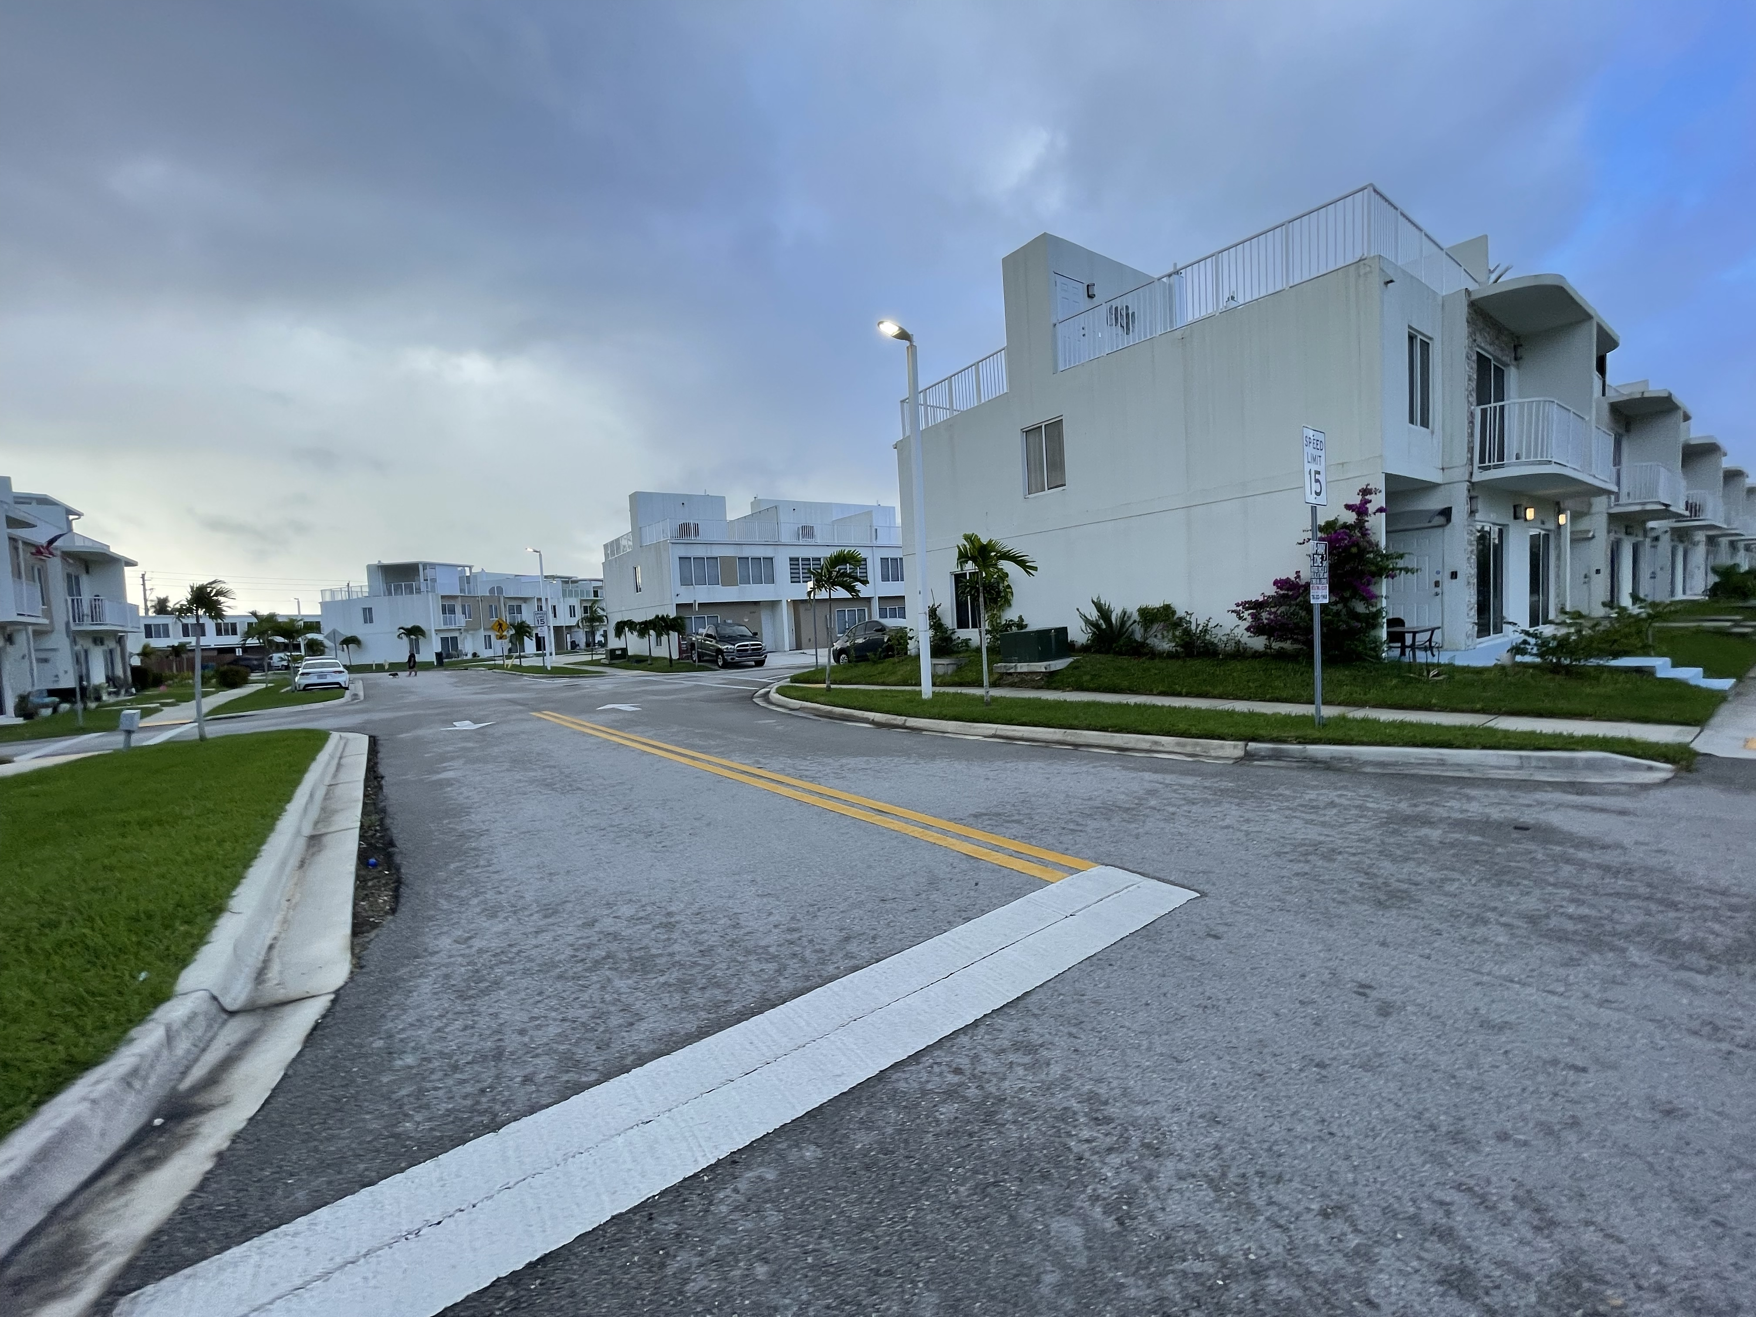
Proposed Parking Additions

Slide 8
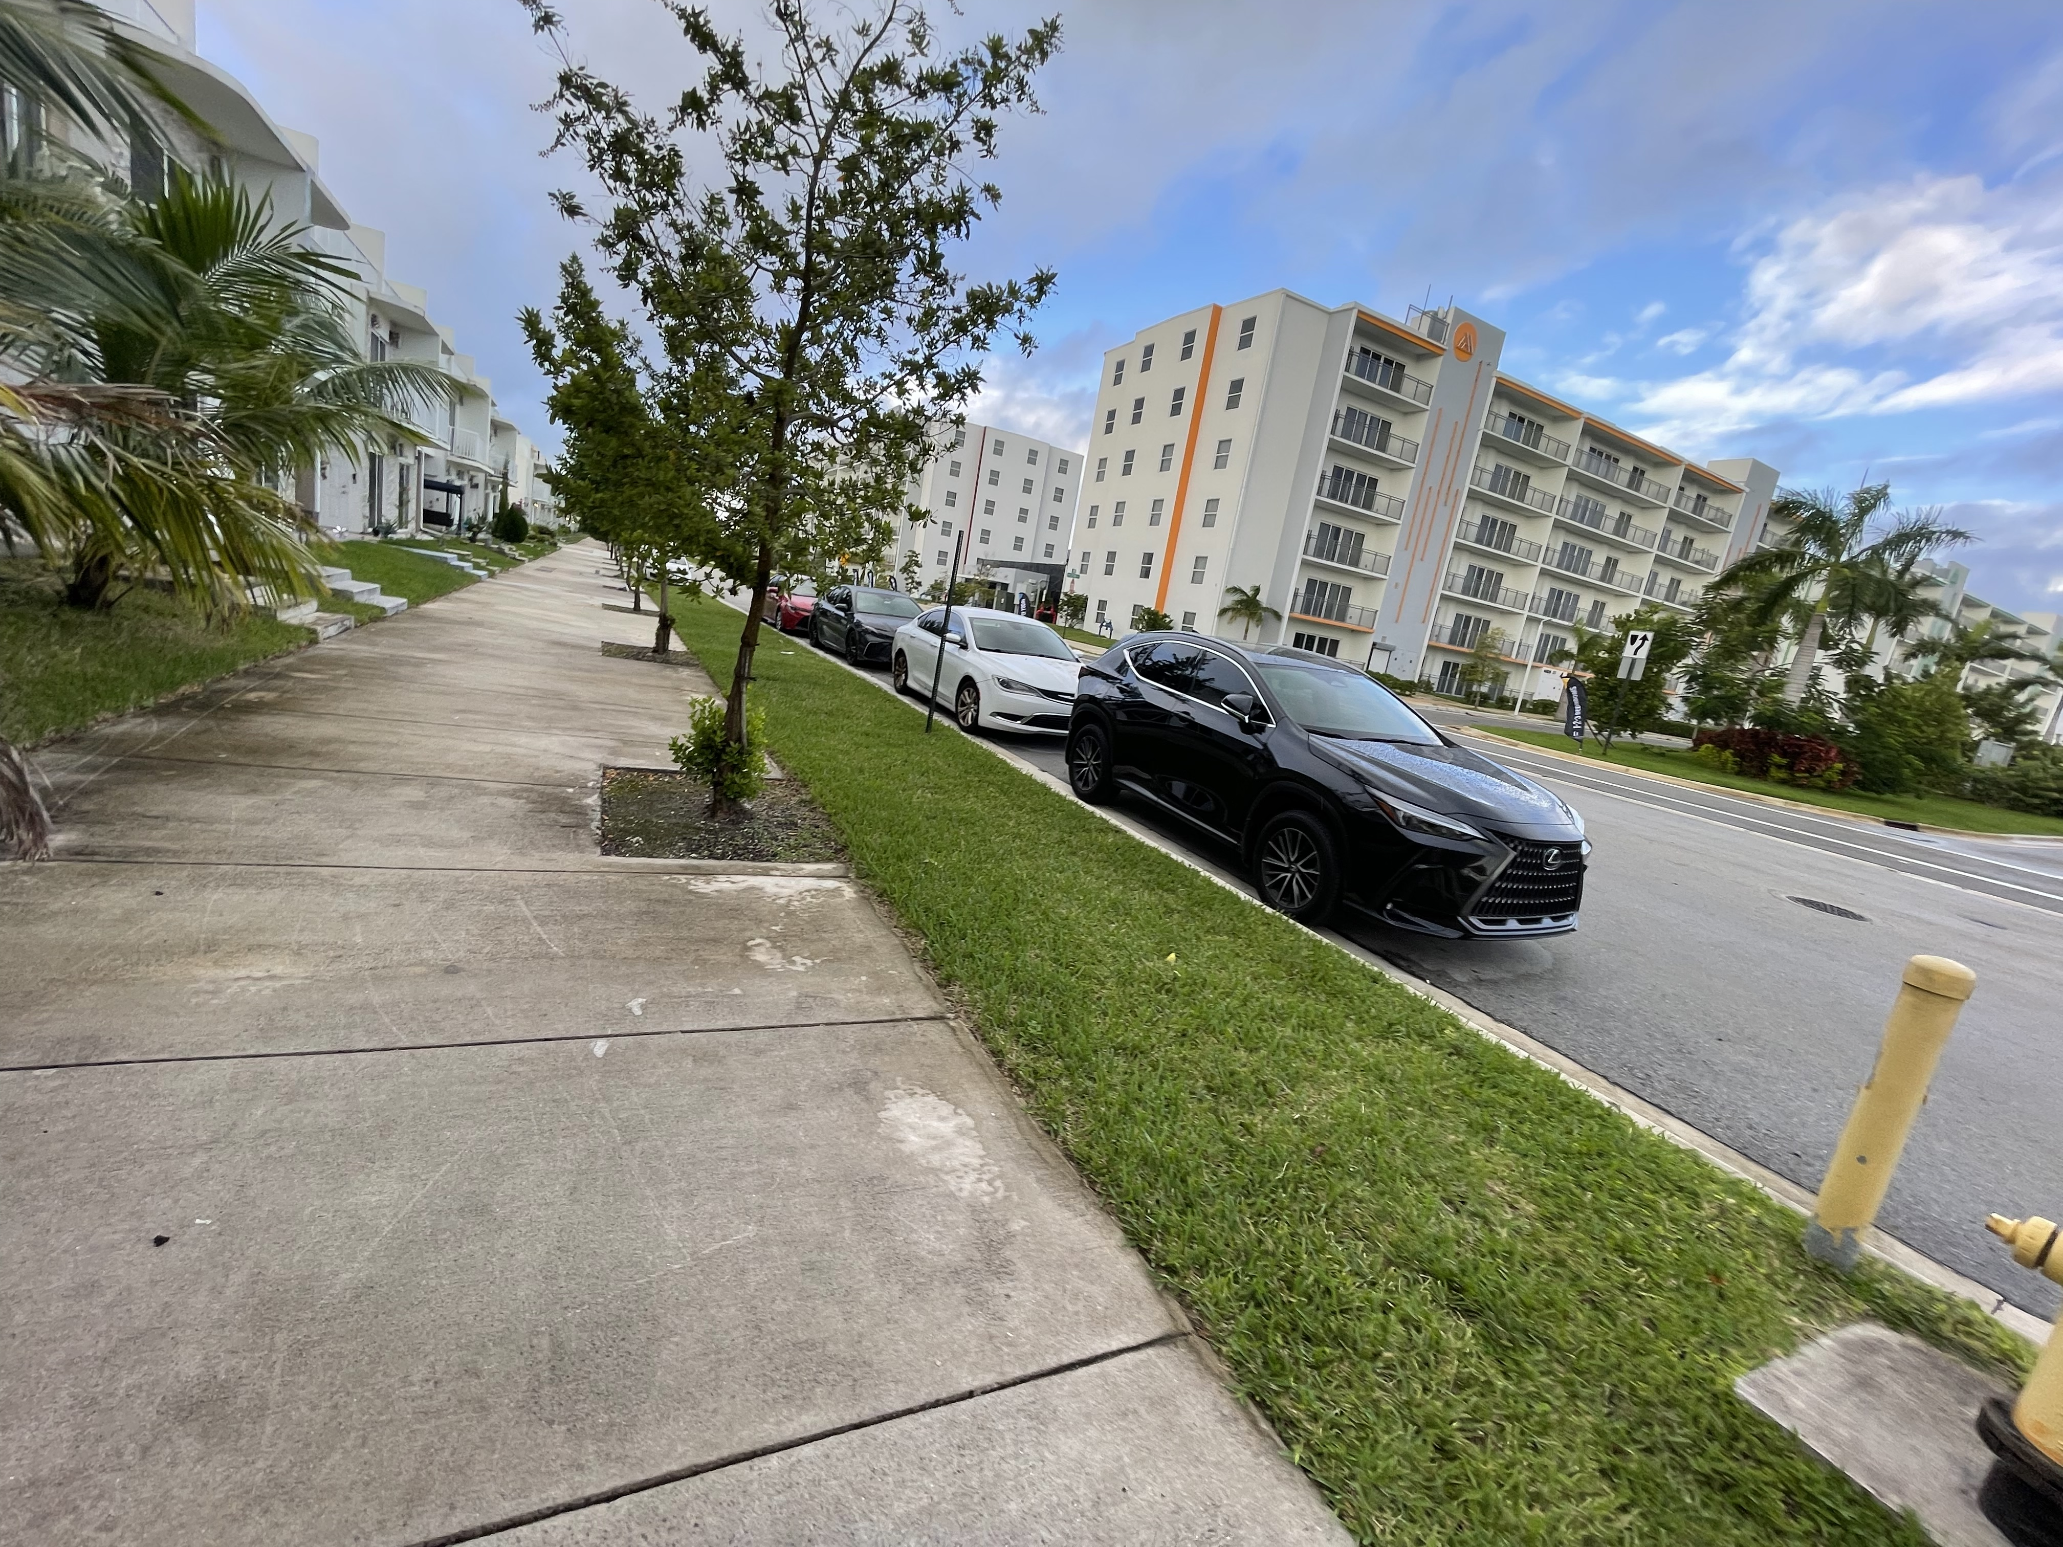
Proposed Parking Additions

Slide 9
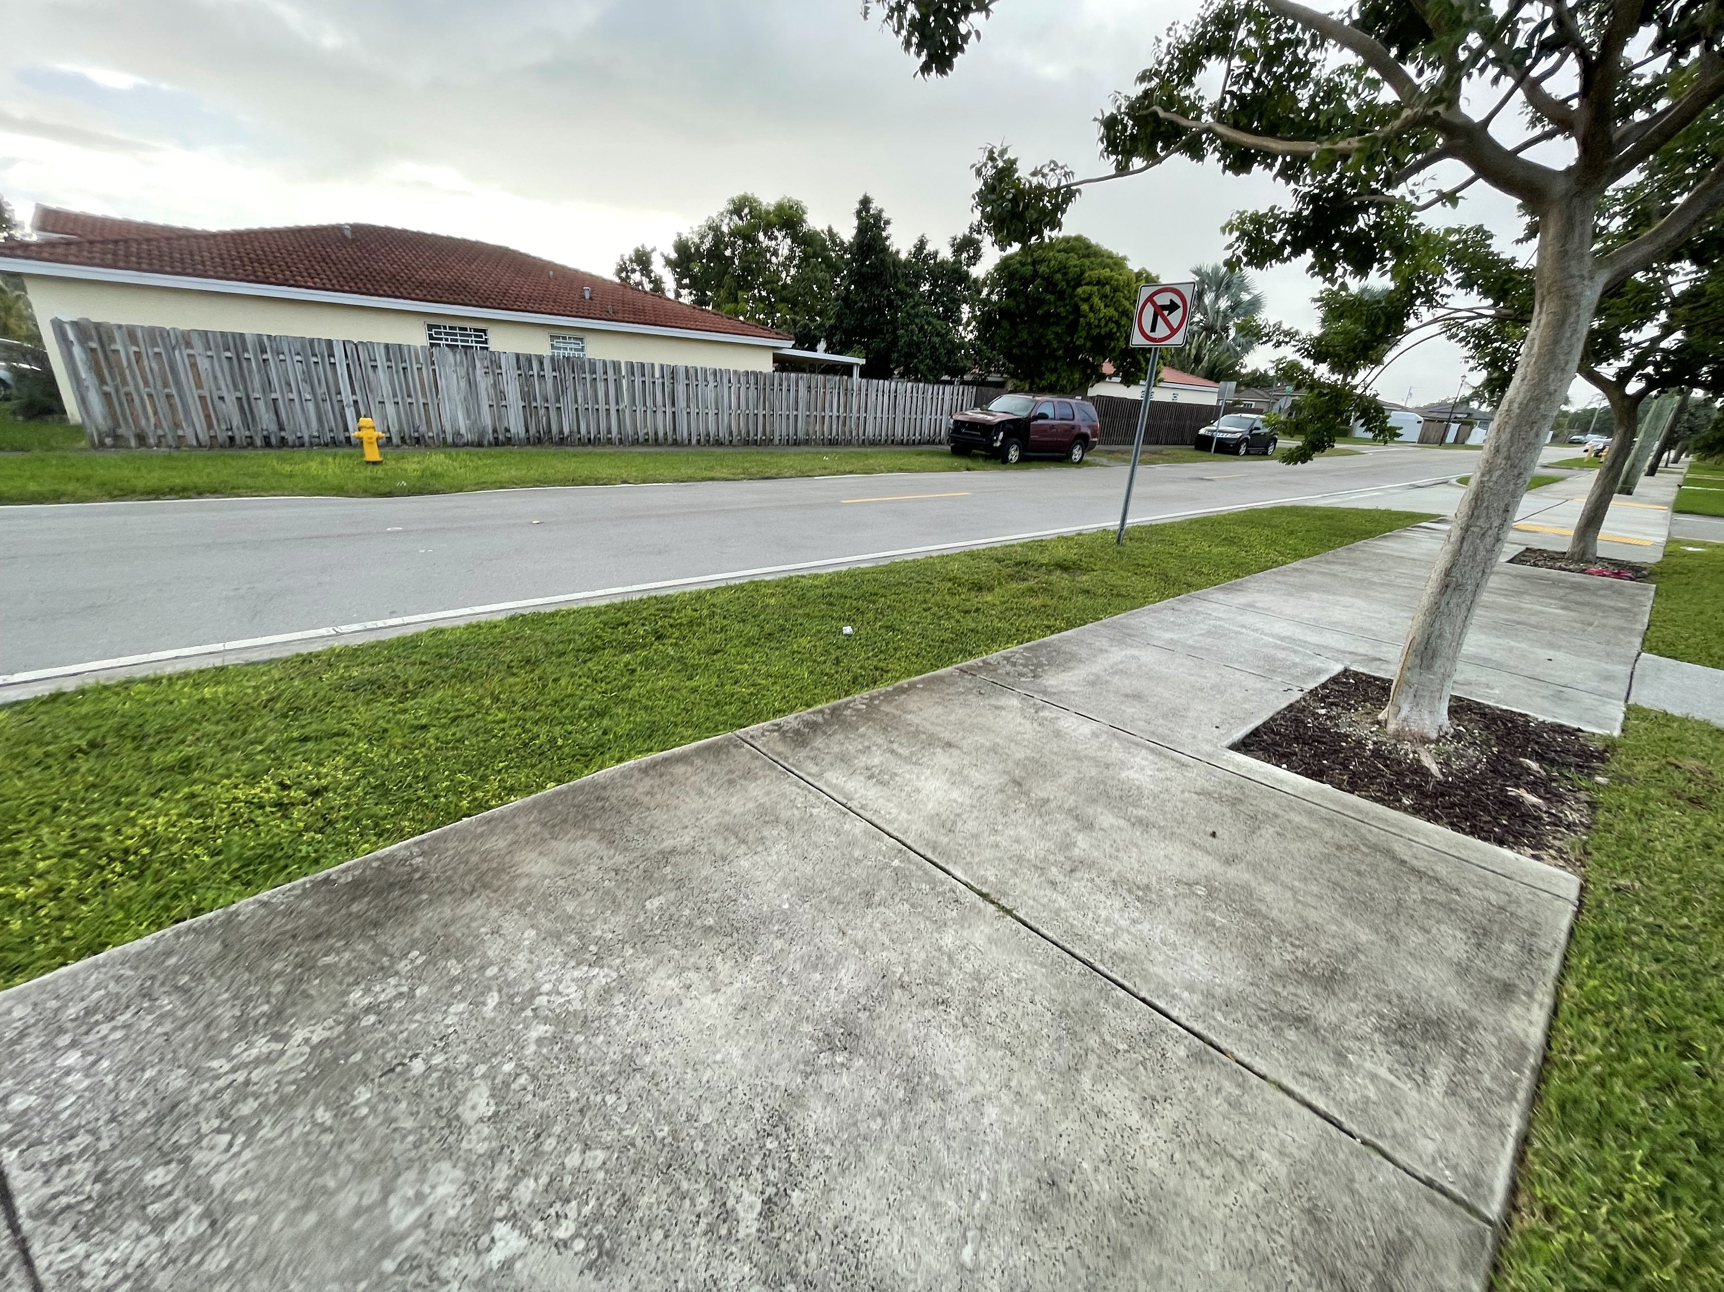
Proposed Parking Additions

Slide 10
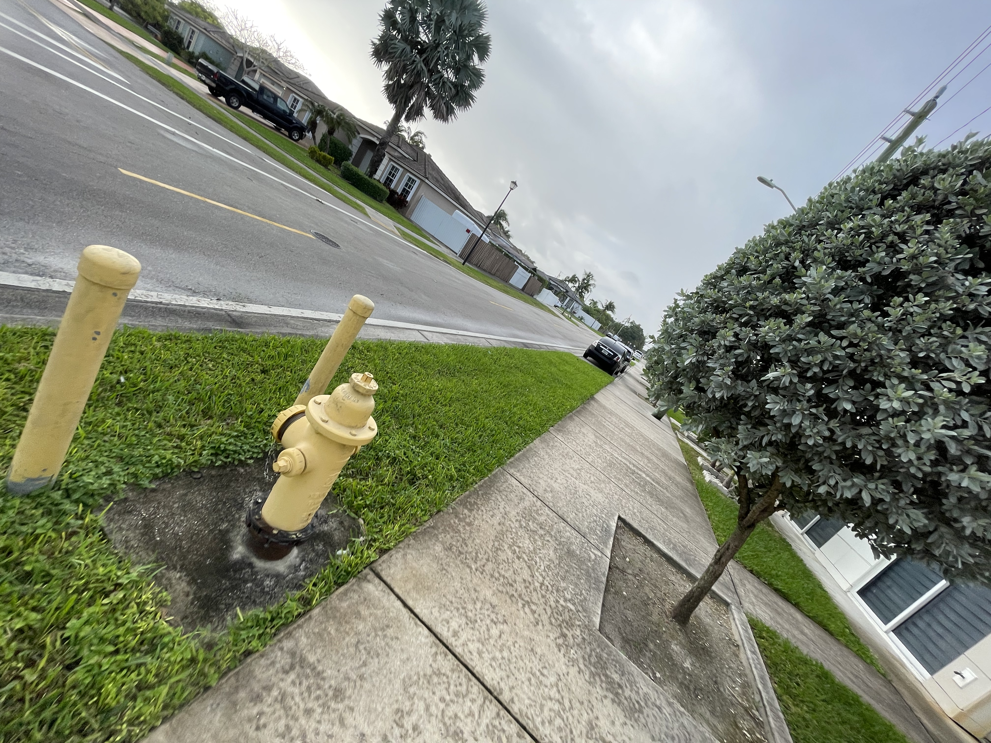
Proposed Parking Additions

Slide 11
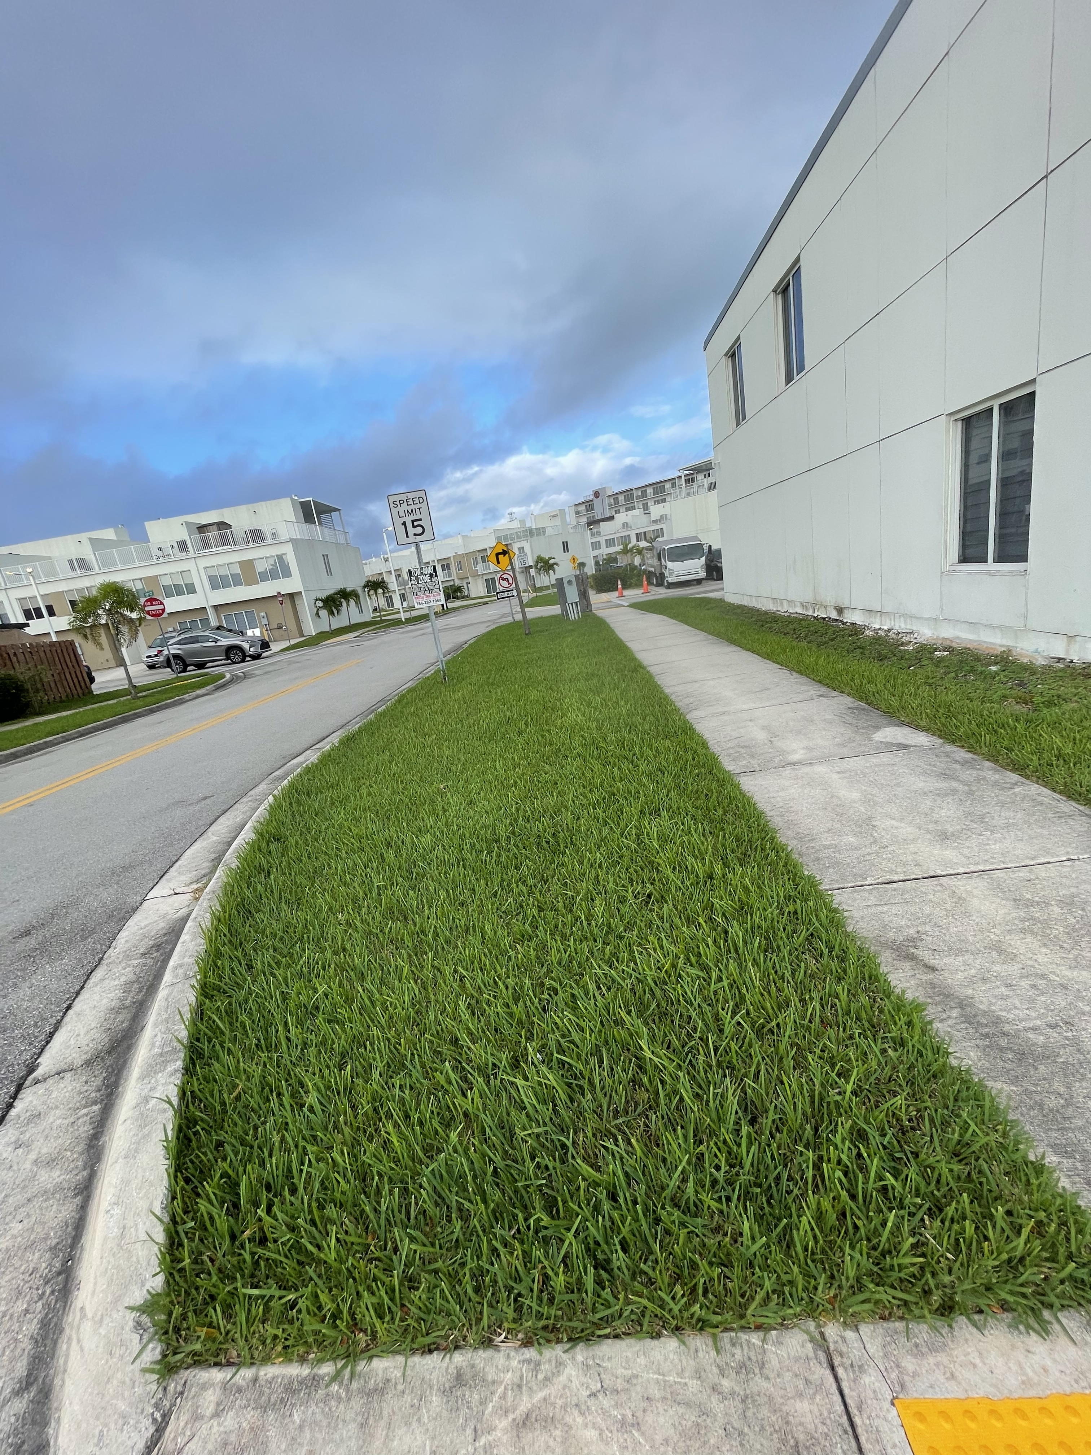
Proposed Parking Additions

Slide 12
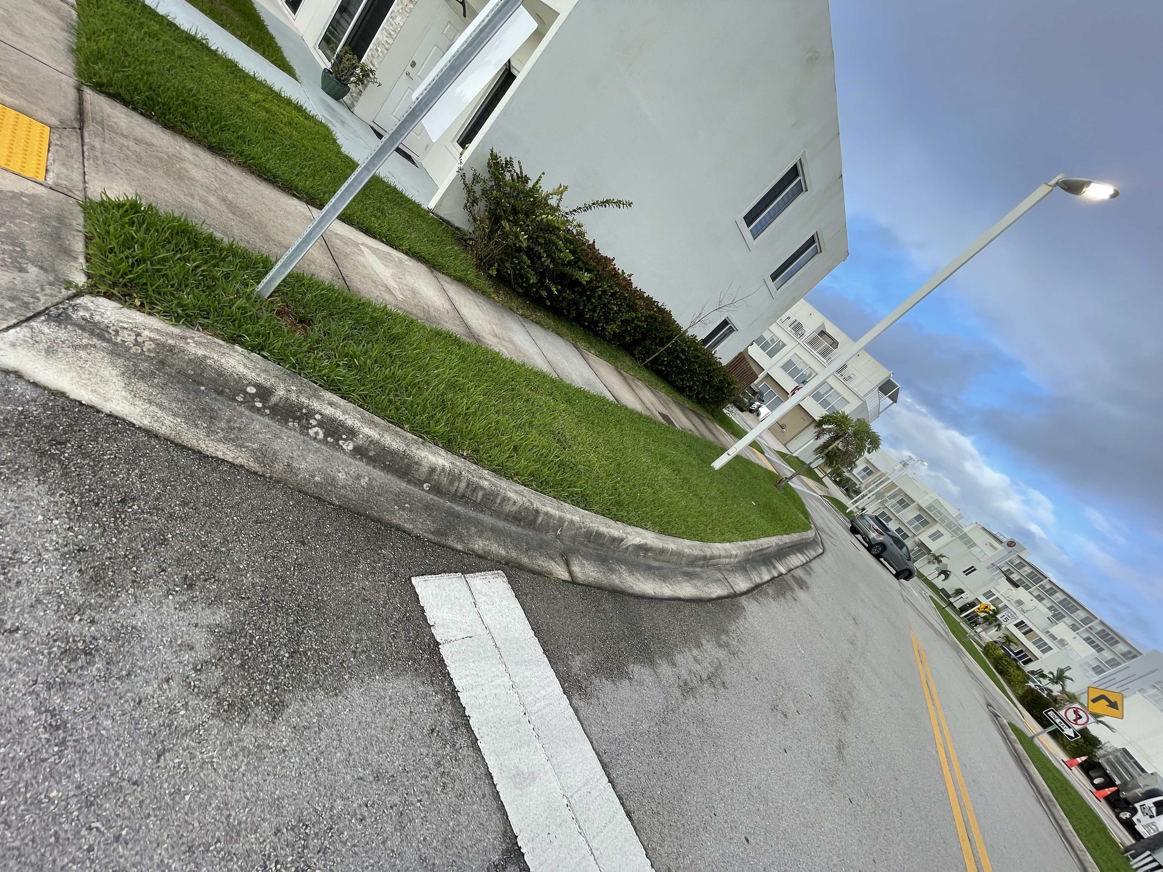
Proposed Parking Additions

Slide 13
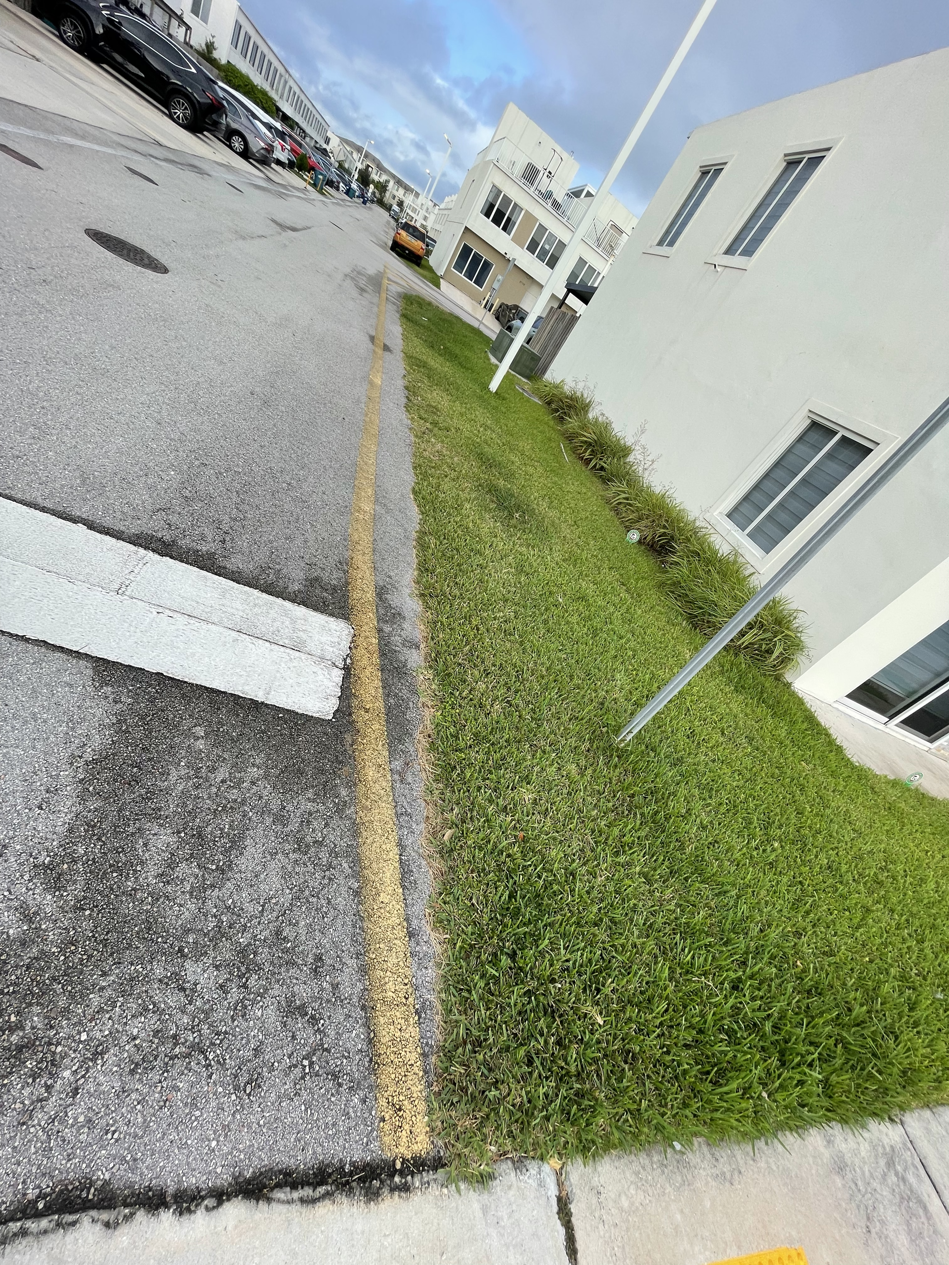
Proposed Parking Additions

Slide 14
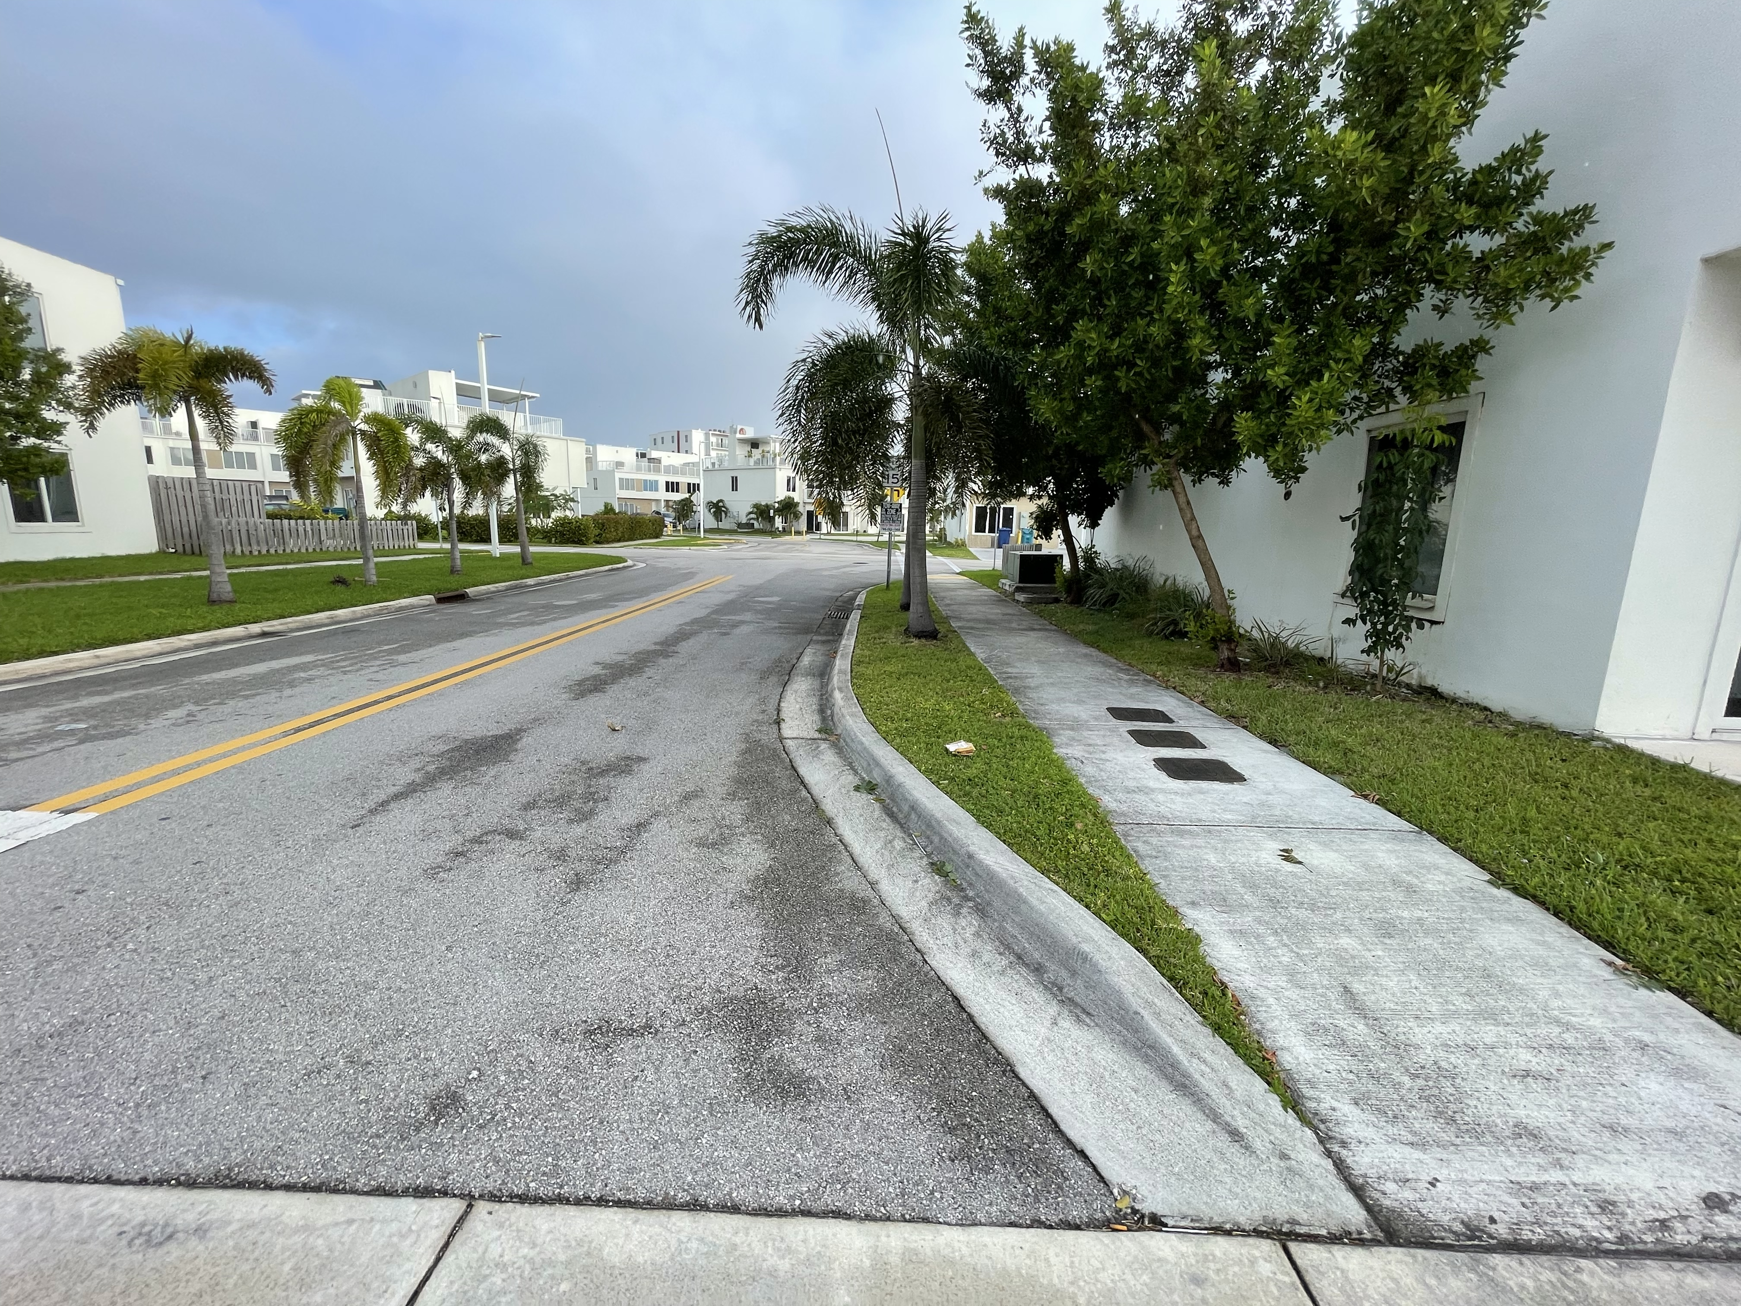
Proposed Parking Additions

Slide 15
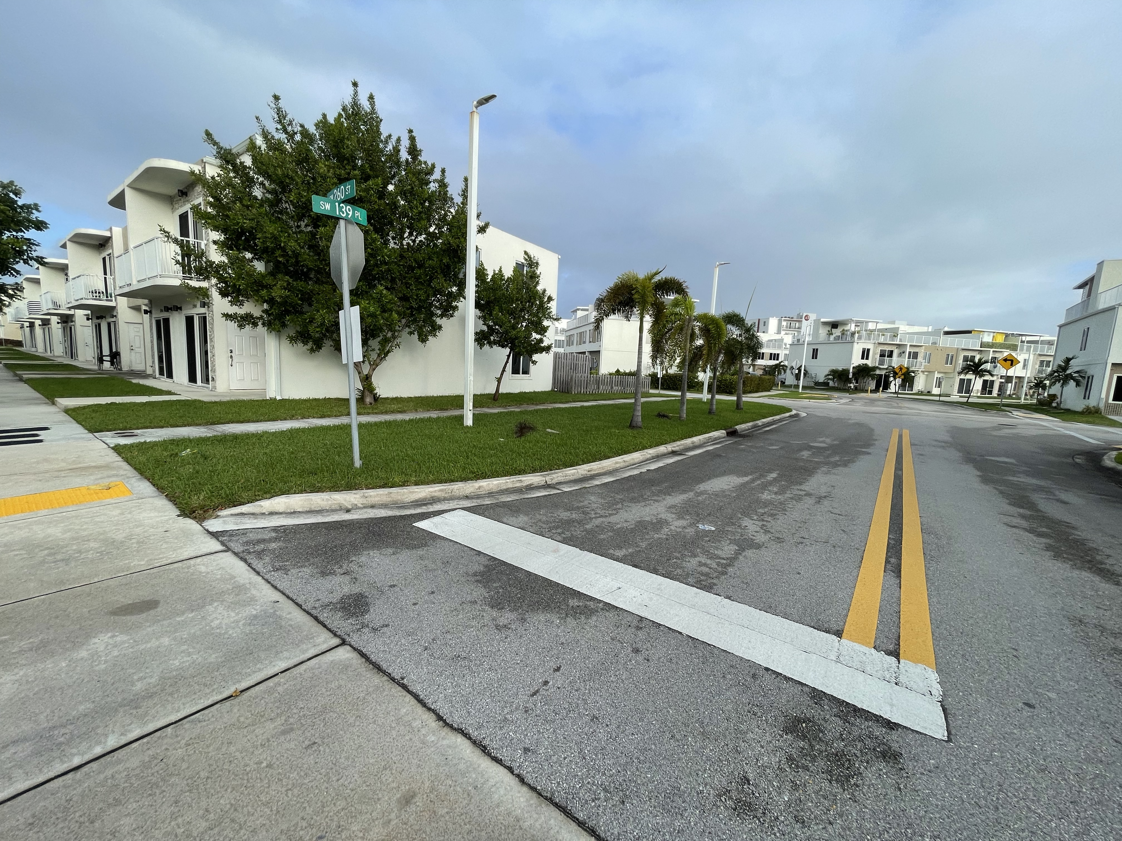
Proposed Parking Additions

Slide 16
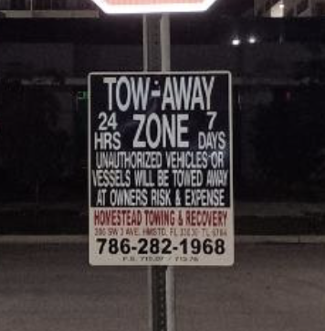
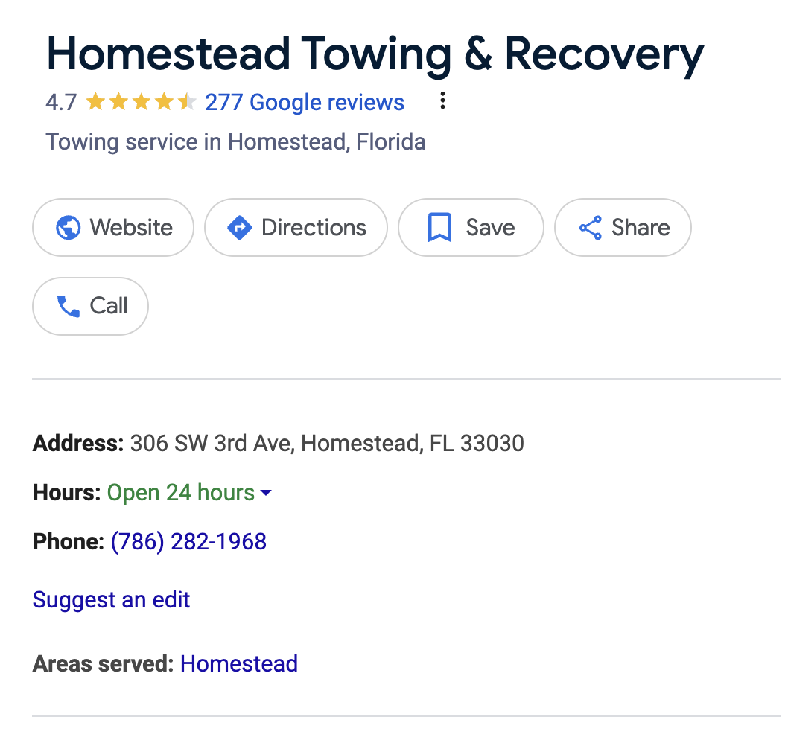
Towing

Slide 17
Towing
Blocking Driveways or Access Points
Parking in a way that blocks driveways, fire hydrants, emergency exits, or other critical access points.
Parking in a No-Parking Zone
Parking in areas marked as "No Parking," which are often intended to maintain clear paths for safety and access.
Obstructing Fire Lanes
Parking in designated fire lanes, which must remain clear for emergency vehicle access.
Parking on Grass or Landscaping
Parking on areas not designated for vehicles, such as grass, landscaped areas, or sidewalks.
Abandoned or Inoperable Vehicles
Leaving a vehicle that appears abandoned, is visibly inoperable, or has not been moved for an extended period.
Double Parking or Blocking Other Vehicles
Parking in a way that prevents other vehicles from exiting their spaces.
Using Visitor Parking for Residents
Repeatedly parking in visitor spots if they are reserved for guests only.
Parking During Restricted Hours
Leaving a vehicle in restricted areas during certain hours (e.g., overnight or during maintenance times).
Illegal Parking (e.g., Blocking Fire Hydrants)
Parking in locations that are legally restricted by city or community rules, such as in front of fire hydrants or crosswalks.
Unauthorized Overnight Parking
Leaving a vehicle parked overnight in areas where overnight parking is prohibited.
Violating Specific HOA or Community Rules
Parking in violation of specific HOA policies or community rules, which could vary by property (e.g., blocking mailboxes or utility access points).

Slide 18
Proposed Towing Solution
Introduction: To maintain a well-organized and fair parking system, we are proposing to contract a towing company to assist with parking management across our community. The goal is to ensure parking spaces remain available and are used appropriately.
Proposed Rules & Monitoring:
72-Hour Rule for Perimeter Vehicles: Vehicles parked along the community perimeter may not occupy the same space for more than 72 hours consecutively.
Regular Monitoring: The towing company will conduct routine inspections to identify vehicles in violation of the community’s parking rules, ensuring that spots are available and properly utilized.
Enforcement of Designated Parking Areas: Unauthorized use of visitor parking, fire lanes, and other restricted areas will be actively monitored, with violators subject to towing.
Benefits of Contracted Towing Services:
Helps maintain fair and available parking for all residents.
Reduces instances of abandoned or long-term parked vehicles in prime spaces.
Increases safety by keeping fire lanes and restricted zones clear.
Next Steps:
Community feedback and approval.
Finalization of contract details with the towing company.
Clear communication of new rules to all residents.

Slide 19
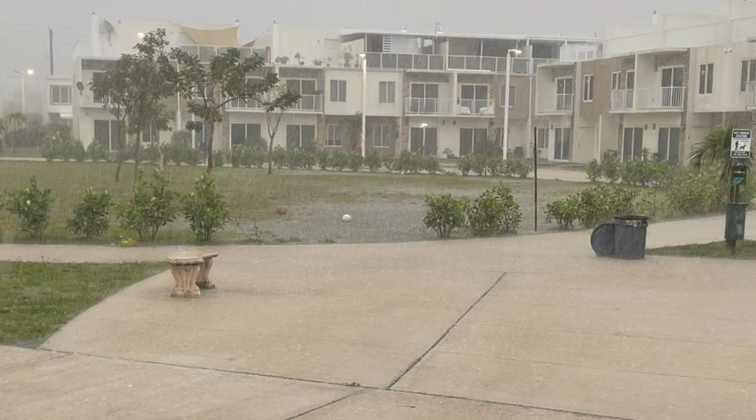
Community Park Improvements
Introduction: Our Community Park is a valuable shared space for relaxation and community gatherings. Due to drainage and flooding issues, adding a playground isn't feasible at this time. However, we’re exploring other ways to enhance the park’s functionality and aesthetics for everyone to enjoy.
Proposed Enhancements:
Lighting Upgrades: Improving park lighting to increase safety and allow for evening use, making the park a more accessible space at all hours.
Bench Repairs and Additional Seating: Repairing damaged benches and adding new seating options, providing comfortable spaces for residents to relax, socialize, or enjoy the park’s natural surroundings.
Functional and Aesthetic Improvements:
Adding more waste bins to promote cleanliness.
Considering shade structures, picnic tables, or small garden areas to improve both functionality and appearance.
Ensuring regular maintenance of the landscaping to keep the park appealing and well-kept.
Introducing Subcommittees for Oversight: To further improve our park and other community areas, we are forming subcommittees to oversee these enhancements and gather resident input. More information on how to join these subcommittees will be provided during the meeting.
Next Steps:
Gather feedback and ideas from residents.
Organize subcommittees to take charge of planning and coordinating these improvements.
Begin budgeting and scheduling for prioritized enhancements.

Slide 20
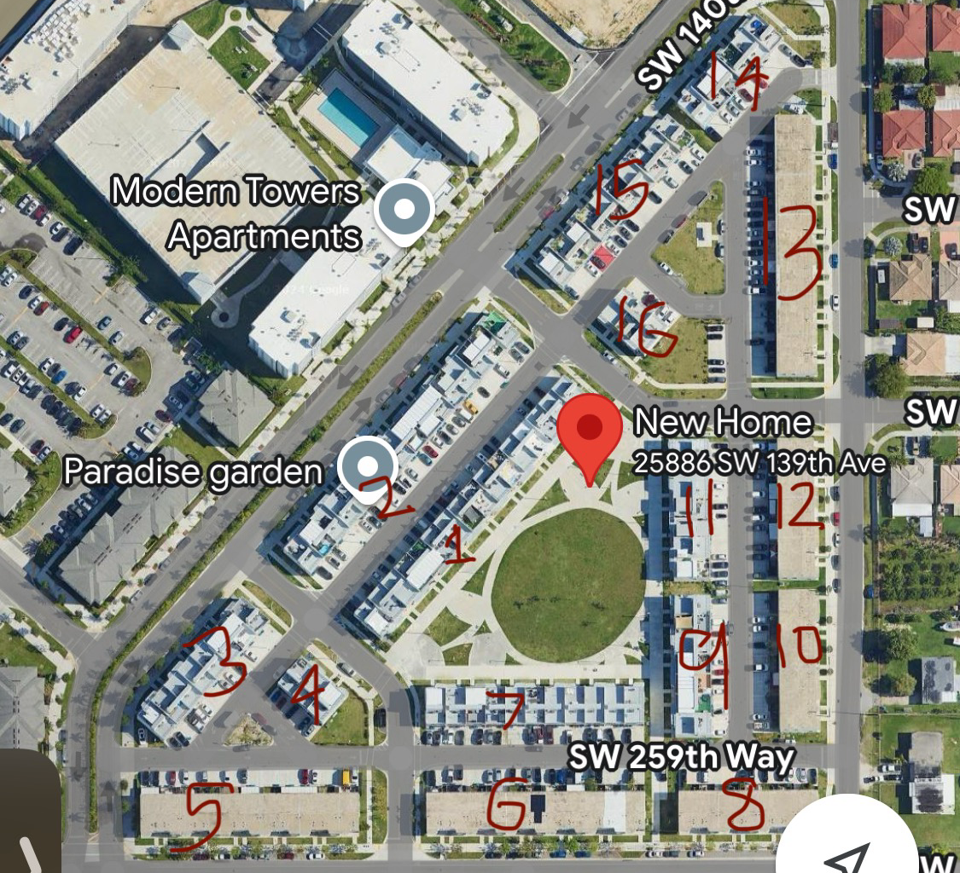
Gutter Replacement Project
Overview: To address drainage issues and prevent water damage, we are undertaking a comprehensive gutter replacement project throughout the community. This project is essential to ensure proper water flow and protect the structural integrity of our homes and common areas.
Project Plan:
Block-by-Block Approach: We are replacing gutters in phases, focusing on one block at a time. This approach allows us to minimize disruption and complete the project efficiently.
Scheduled Replacements: Each block will be scheduled for gutter replacement, with notices sent to residents in advance. This ensures everyone is informed about when work will occur in their area.
Quality Materials & Installation: Using durable materials and professional installation to ensure long-lasting gutter systems that will effectively manage rainwater.
Benefits of the Gutter Replacement Project:
Improves drainage throughout the community.
Reduces the risk of water damage to homes and landscaping.
Helps maintain the cleanliness and safety of shared outdoor areas.
Next Steps:
Continue block-by-block replacements until all areas are completed.
Regular updates will be provided to residents regarding progress and scheduling.
Community Feedback: We encourage residents to reach out with any concerns or suggestions regarding the gutter replacement. Your input helps us address issues proactively and make adjustments as needed.

Slide 21
Community Signs
Introduction: To build a stronger sense of identity and enhance the appearance of our neighborhood, we propose the installation of custom signs at each of the three entrances to our community. These signs will not only provide a welcoming entrance but also help establish a cohesive and recognizable identity for Paradise Gardens.
Proposal Details:
Sign Locations: Install three prominent signs, one at each entrance to the community, to mark our boundaries and make it clear to residents and visitors that they are entering Paradise Gardens.
Sign Design Goals:
Reflect the unique character and welcoming nature of our community.
Use durable, weather-resistant materials to ensure longevity.
Incorporate elements that align with our landscaping and color themes for a cohesive look.
Benefits:
Establishes a clear identity for Paradise Gardens.
Enhances curb appeal and community pride.
Creates a more welcoming environment for residents and guests.
Community Feedback: We encourage residents to share ideas or preferences for the sign design, colors, and materials. Your input will help us create signs that truly represent our community.

Slide 22
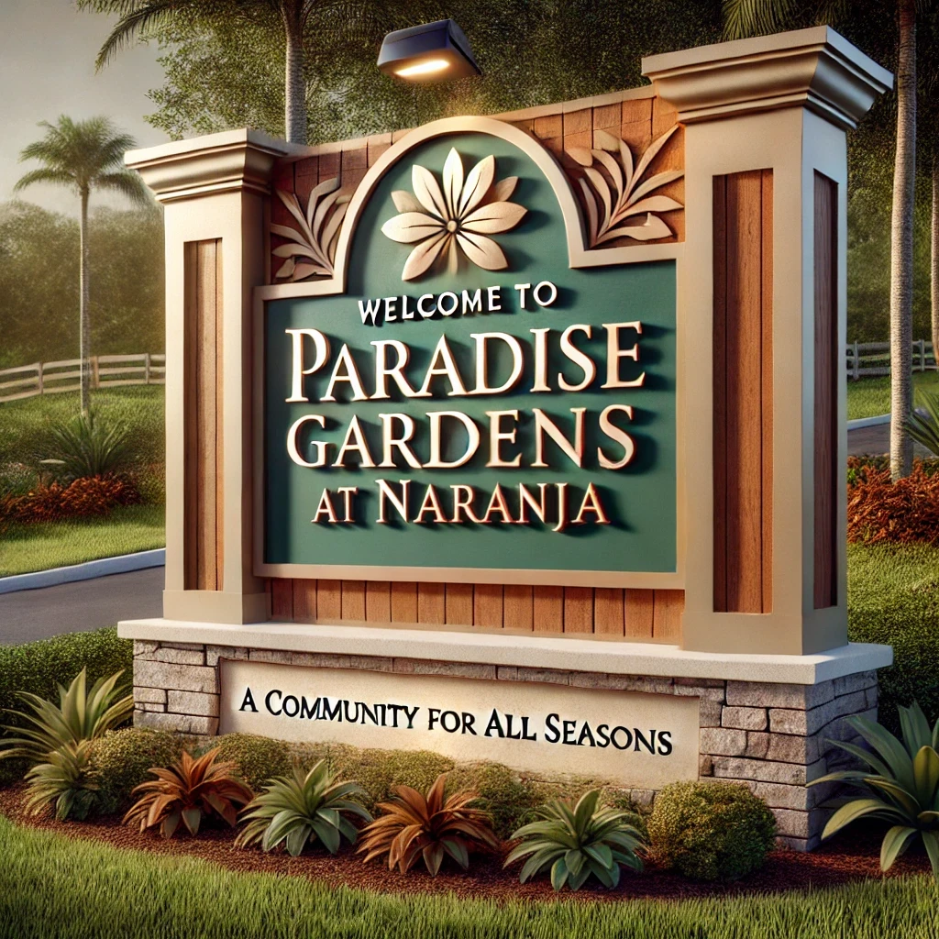
Sample Theoretical Community Sign Design
Text on Sign: "Welcome to Paradise Gardens at Naranja" Subtitle: "A Community for All Seasons"
Design Elements:
Color Scheme: Earth tones with accents of deep green and warm beige to match the natural landscape.
Materials: Brushed metal or wood composite with a weather-resistant finish.
Additional Elements:
A stylized palm tree or floral motif to reflect the Florida setting.
A small solar-powered light fixture at the top to softly illuminate the sign at night.
A stone or brick base for added stability and a classic aesthetic.

Slide 23
Fall Festival – December Neighborhood Celebration
Introduction: To bring our community together in the spirit of the holiday season, we’re planning a Fall Festival in December! This neighborhood block party, or "verbena," will be a fun-filled event where residents of all ages can come together, enjoy great food, dance, and celebrate as a community.
Event Highlights:
Food Trucks & Local Vendors A variety of food trucks and local vendors will be on-site, offering delicious food and treats for everyone to enjoy. A great chance to support local businesses while indulging in a diverse selection of food!
Bounce Houses & Kid-Friendly Activities Bounce houses and play areas will be set up for children, making it a family-friendly event where kids can play and have a blast in a safe environment.
Live Music & Dancing We’ll have live music to get everyone in the festive spirit! Residents can dance, relax, or simply enjoy the entertainment.
Holiday-Themed Decorations & Photo Ops Decorated areas for festive photos to capture memories with friends, family, and neighbors.
Community Bonding Activities Fun games, contests, and activities designed to bring neighbors together, encourage interaction, and build a stronger sense of community.

Slide 24
Fall Festival – December Neighborhood Celebration
Event Goals:
Strengthen the bonds among community members.
Create a welcoming, festive atmosphere that everyone can enjoy.
Offer a chance for residents to relax, have fun, and celebrate the holiday season together.
Next Steps:
Finalize event details and share a schedule with residents.
Coordinate with food vendors, entertainment, and set up in the park.
Collect volunteers interested in helping with event setup, decorations, and activities.
Get Involved! Residents who would like to help with the planning or volunteer during the event are encouraged to reach out. Together, we can make this event a memorable celebration for our entire community! (More on this in the subcomittees!)

Slide 25
Cleanliness & Tidiness in Our Community
Introduction: Maintaining a clean and tidy environment is essential for keeping our community enjoyable and welcoming for everyone. By taking pride in our community and being responsible neighbors, we can ensure Paradise Gardens remains a pristine and safe place to live.
Guidelines for Cleanliness:
Clean Up After Yourself: Whether using shared spaces, parking areas, or the community park, please remember to pick up any trash or belongings.
Supervise Children: Ensure children are playing safely and responsibly in community areas, helping to maintain a peaceful and orderly environment.
Dispose of Large Waste Properly:
We can designate a day each week for large waste removal, which can be scheduled through an appropriate subcommittee.
Alternatively, residents can arrange for large item disposal directly through Miami-Dade County at 311.
Pet Clean-Up:
Clean up after your pets in shared areas.
Utilize the pet waste stations provided throughout the community to help keep our spaces clean and enjoyable for all.
Take Pride in Our Community: By following these guidelines, we can all contribute to a well-maintained and beautiful neighborhood that reflects our shared pride and respect for each other.
Next Steps:
Form a subcommittee to coordinate cleanliness efforts and manage the schedule for large waste removal.
Encourage residents to participate in keeping our community spaces clean and orderly.

Slide 26
USPS/Mail Issues and Proposed Solution
Overview of the Issue: Our community has been experiencing ongoing issues with misdelivered mail, including mail being placed in incorrect mailboxes. Despite multiple conversations with USPS, the problem persists, affecting residents' ability to receive their mail accurately and on time.
Proposed Solution:
Community Mail Correction Box: We propose creating a designated box for mail that has been placed in the wrong mailbox. Residents who receive mail not intended for them can simply place it in this community box.
Weekly Redistribution by Subcommittee: A dedicated subcommittee can be responsible for checking this box once a week and redistributing the misdelivered mail to the correct addresses within the community.
Benefits of This Solution:
Provides a convenient way for residents to handle misdelivered mail.
Ensures that misdelivered items reach the correct recipients in a timely manner.
Reduces frustration caused by frequent mailing errors.
Next Steps:
Form a subcommittee to oversee the management of the mail correction box and the weekly redistribution process.
Communicate this solution to all residents and encourage participation.
Resident Cooperation: We ask all residents to participate by placing misdelivered mail in the designated box, helping us maintain an organized and functional solution for our mail issues.

Slide 27
Security and Safety in Our Community
Overview of the Concern: Safety and security are essential to maintaining a peaceful and comfortable environment in our community. To enhance our neighborhood’s security, we are considering options to ensure that all residents feel safe and secure in Paradise Gardens.
Proposed Solutions:
Neighborhood Watch Program:
This program would involve community volunteers to actively monitor and report any suspicious activity.
Volunteers would coordinate with each other and remain vigilant, promoting a safer environment.
Benefits: Cost-effective and promotes a strong sense of community.
Hiring a Security Company:
Employing a professional security company to patrol the community, either on foot or in vehicles.
Regular patrols by trained security personnel to deter potential threats and respond to incidents.
Benefits: Provides a reliable and professional security presence, offering peace of mind for all residents.
Next Steps:
Gather community feedback on the preferred approach: Neighborhood Watch or Security Company.
For the Neighborhood Watch, recruit volunteers interested in participating and organizing the program.
For the Security Company, obtain quotes and assess the feasibility of integrating professional patrols.
Community Involvement: We encourage residents to share their thoughts on these options and consider participating if a Neighborhood Watch program is chosen. Together, we can create a safer and more secure environment for everyone.

Slide 28
Subcommittees
Here is a list of potential subcommittees that could be beneficial for Paradise Gardens, each focused on specific community needs:
Parking & Towing Subcommittee
Manages parking regulations, identifies parking solutions, and addresses resident concerns about towing.
Lighting Subcommittee
Oversees the maintenance and repair of streetlights and outdoor lighting, coordinates with service providers, and ensures adequate lighting in public areas for safety.
Gutter & Maintenance Subcommittee
Monitors and plans maintenance for gutters, drainage, and other structural upkeep, ensuring community infrastructure remains in good condition.
Signage & Aesthetics Subcommittee
Focuses on consistent, appealing signage and aesthetics for the community. Assists with signage updates, public notices, and visual improvements.
Holiday & Events Planning Subcommittee
Organizes community events like the December holiday gathering, fall festival, and contests, fostering neighborhood spirit and engagement.

Slide 29
Subcommittees
Cleanliness & Public Spaces Subcommittee
1. Promotes cleanliness and proper use of shared spaces. Plans clean-up days, ensures maintenance of playgrounds, parks, and public areas, and sets guidelines for tidiness.
Mail & USPS Communication Subcommittee
Works with USPS to resolve mail issues, addresses resident concerns about missing mail, and coordinates mail system improvements if needed.
Aesthetic Standards Subcommittee
Develops and maintains guidelines for consistent aesthetics (e.g., exterior paint, floors, landscaping) to ensure a cohesive look across the community.
Pet & Animal Control Subcommittee
Sets policies for pet care in shared spaces, addresses issues related to pet waste, leashing, and educates residents on responsible pet ownership.
Safety & Security Subcommittee
Focuses on improving neighborhood security, coordinates with security services, evaluates safety features (e.g., cameras), and identifies potential hazards in public areas.

Slide 30
Subcommittees
Community Engagement & Communications Subcommittee
Manages communication channels, including newsletters, social media, and bulletin boards, to keep residents informed and engaged.
Landscaping & Beautification Subcommittee
Oversees the beautification of shared spaces, planning for landscaping improvements, tree care, seasonal plantings, and other projects to enhance community appearance.
Rules & Compliance Subcommittee
Works to ensure residents follow HOA rules, helps mediate minor disputes, and educates residents on community guidelines and expectations.
Volunteer Coordination Subcommittee
Manages volunteer efforts for community projects, clean-ups, and events, helping recruit and organize residents willing to help with various initiatives.
Emergency Preparedness Subcommittee
Plans for emergencies (e.g., hurricanes, power outages), coordinates safety drills, and ensures the community is prepared with necessary resources and information.

Slide 31
Subcommittees
Safety & Security Subcommittee
Committee Lead:
Volunteer 1:
Volunteer 2:
Landscaping & Beautification Subcommittee
Volunteer 1:
Volunteer 2:
Engagement & Communications Subcommittee
Committee Lead:
Volunteer 1:
Volunteer 2:
Rules & Compliance Subcommittee
Committee Lead:
Volunteer 1:
Volunteer 2:
Volunteer Coordination Subcommittee
Committee Lead:
Volunteer 1:
Volunteer 2:
Emergency Preparedness Subcommittee
Committee Lead:
Volunteer 1:
Volunteer 2:
Holiday & Events Planning Subcommittee
Committee Lead: Joe Schulz
Volunteer 1:
Volunteer 2:
Volunteer 3:
Volunteer 4:
Cleanliness & Public Spaces Subcommittee
Committee Lead:
Volunteer 1:
Volunteer 2:
Mail & USPS Communication Subcommittee
Committee Lead:
Volunteer 1:
Volunteer 2:
Aesthetic Standards Subcommittee
Committee Lead:
Volunteer 1:
Volunteer 2:
Pet & Animal Control Subcommittee
Committee Lead:
Volunteer 1:
Volunteer 2:
Parking & Towing Subcommittee
Committee Lead:
Volunteer 1:
Volunteer 2:
Lighting Subcommittee
Committee Lead:
Volunteer 1:
Volunteer 2:
Gutter & Maintenance Subcommittee
Committee Lead:
Volunteer 1:
Volunteer 2:
Signage & Aesthetics Subcommittee
Committee Lead:
Volunteer 1:
Volunteer 2:

Slide 32
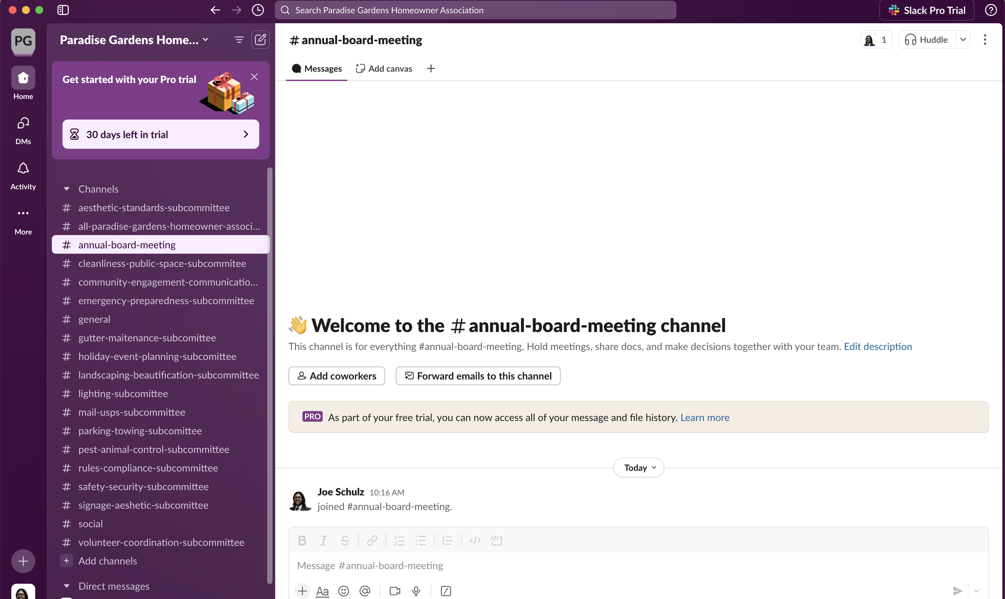
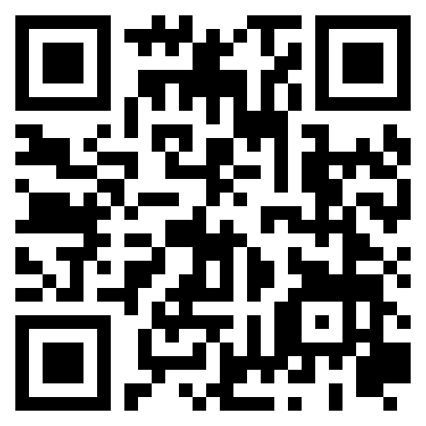
New Committee Members: Scan the QR Code to Download Slack

